Slide 1
Electrons.com
Submit to-
Lavish Arora Sir
By-
Mridul kaushal (2010990466)

Slide 2
INtroduction
Foodies.com is a food ordaring website. One can find almost every popular dish on this. It’s very easy to use and is user friendly. This website is currently under development. Here are some glimpse of this website.

Slide 3

Home page
This is home page of this website.

Slide 4

About us Page
This is about us of this website.

Slide 5
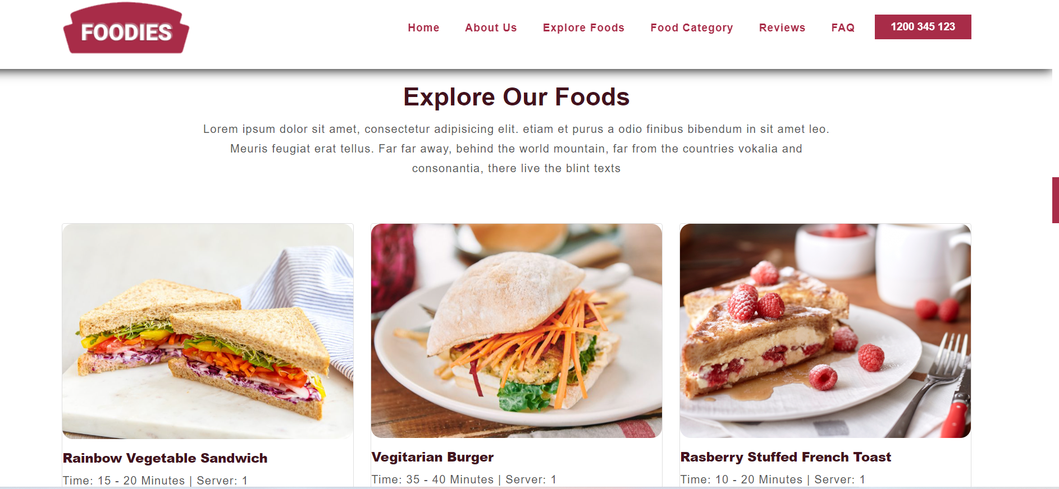
Explore food page
This is explore food page of this website.

Slide 6
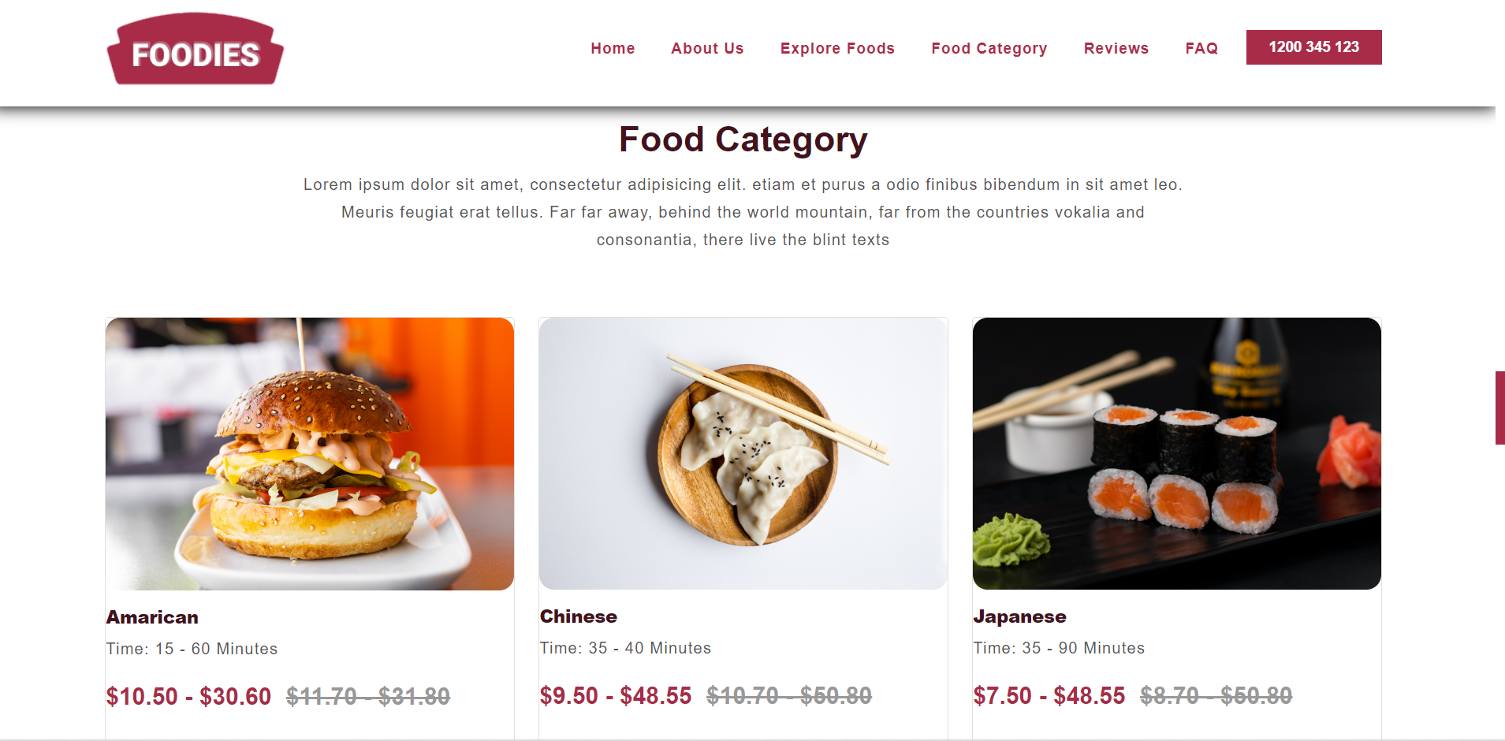
Food category page
This is food category page of this website.

Slide 7
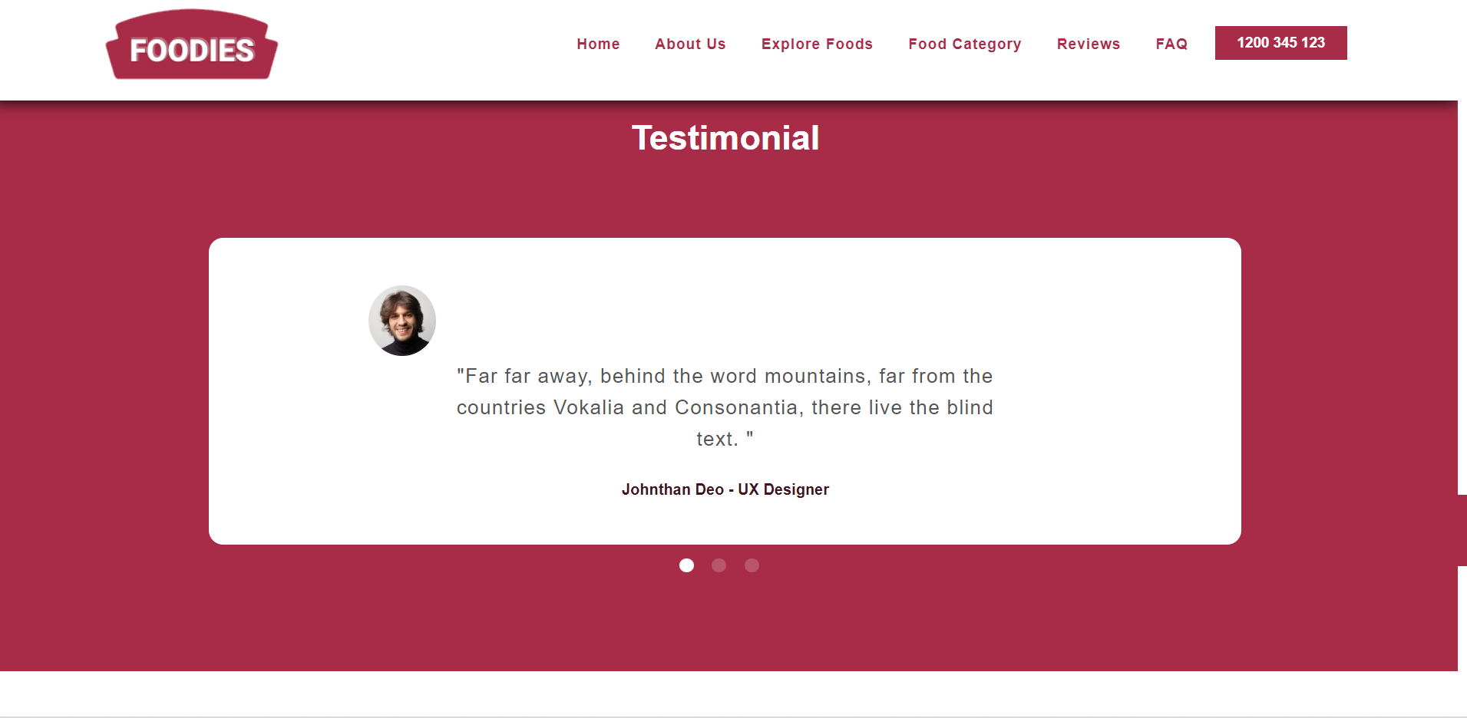
Reviews You can give your reviews and improvement for this website

Slide 8
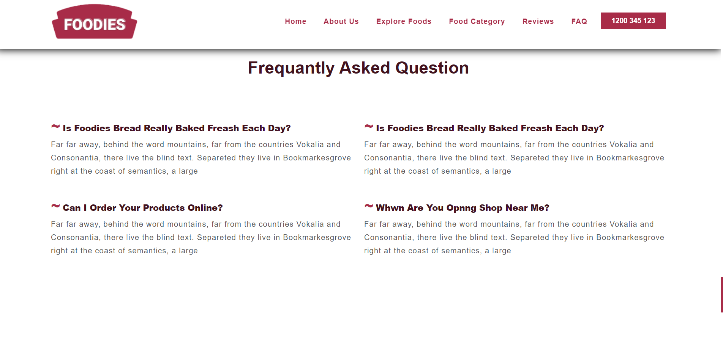
FAQ page this my FAQ page

Slide 9

Footer section page This footer of my website

Slide 10
conclusion
This is not end of this website development. There is a lot more to come.

Slide 11
Thank you…

